Slide 1

ARKA SHINE
INNOVATION IN AGRICULTURE
VANSHIKA B

Slide 2
INTRODUCTION
SOIL SPECTROSCOPY, PARTICULARLY IN THE VISIBLE AND NEAR-INFRARED (VIS-NIR) RANGE, OFFERS A WEALTH OF INFORMATION ABOUT SOIL COMPOSITION AND PROPERTIES. HERE'S A BREAKDOWN OF KEY POINTS FROM YOUR TEXT:
Reflectance and Wavelengths:
●Soil spectroscopy involves analyzing reflectance at various wavelengths.
●Wavelength ranges include visible (400-780 nm), near-infrared (NIR) (780-2500 nm), and combinations like short-wave infrared (SWIR) (1000-2500 nm).
●Absorption at different wavelengths indicates chemical composition, with visible absorption mainly due to electron excitation and longer wavelengths indicating vibrations in chemical bonds.
Advantages of vis-NIR Spectroscopy:
●Rapid real-time analysis.
●Minimal sample preparation.
●Non-destructive and non-invasive.
●Flexible and capable of analyzing multiple parameters simultaneously.
●Rugged instruments suitable for field analyses.
Information Extracted from vis-NIR:
●Strong absorption by water and vibrations of molecular bonds (C-H, O-H, N-H, and C=O).
●Successfully used in agriculture, food industry, pharmaceuticals, medicine, petrochemicals, etc.
Pioneers and History:
●Karl Norris pioneered NIR spectroscopy for fast determination of wheat composition in the 1950s.
●William Herschel discovered NIR radiation in 1800.
Factors Influencing Soil Spectra:
●Water content.
●Clay minerals.
●Organic matter.
●Soil structure.

Slide 3
INTRODUCTION
THE MEASUREMENT OF SOIL ORGANIC MATTER (SOM) CONTENT IS A CRITICAL PROCEDURE IN CARBON CYCLE STUDIES AND FOREST MANAGEMENT. USING SPECTROSCOPIC TECHNIQUES INSTEAD OF LABORATORY ANALYSIS METHOD CAN SIGNIFICANTLY IMPROVE THE TIMELINESS OF THE SOM DETERMINATION PROCESS. HOWEVER, THE SPECTRAL RESPONSE OF SOM FEATURES MANY NARROW WAVE BANDS AND A LARGE AMOUNT OF DATA, RESULTING IN INFORMATION REDUNDANCY. MOREOVER, MANY ENVIRONMENTAL FACTORS CAN AFFECT THE SPECTRAL RESPONSE OF SOM, SUCH AS SOIL WATER CONTENT, SOIL IRON CONTENT, AIR TEMPERATURE, AND HUMIDITY . THESE FACTORS AFFECT THE CHARACTERISTICS AND THE ANALYSIS OF THE SPECTRAL RESPONSE OF SOIL, WHICH INCREASES THE DIFFICULTY IN USING HYPERSPECTRAL DATA TO PREDICT SOM CONTENT . RELATED STUDIES SHOW THAT THE KEY TO IMPROVING THIS TYPE OF PREDICTION ACCURACY LIES IN EFFECTIVE SOIL SPECTRAL BAND SELECTION AND MODELING . LARGE NUMBER OF STUDIES HAVE BEEN CARRIED OUT ON SPECTRAL BAND SELECTION AND MODELING THAT WERE DESIGNED TO IMPROVE THE ACCURACY OF SPECTRAL PREDIC?TION.

Slide 4
INTRODUCTION
IT IS EVIDENT THAT EXPLORING THE MOST SUITABLE BAND SELECTION AND SELECTING THE APPROPRIATE COMBINATION OF MODELING METHODS ARE STILL THE KEY PROBLEMS IN THE FIELD OF HYPERSPECTRAL PREDICTION MODELING OF SOIL PROPERTIES. ML TECH?NIQUES HAVE PROVED TO BE EFFECTIVE IN DEALING WITH LARGE AMOUNTS OF SOIL SPECTRAL VARIABLES [26– 29]. THE TECHNIQUES MENTIONED ABOVE HAVE BEEN APPLIED TO OBTAIN PREDICTION MODELS OF SOIL PROPERTIES. HOWEVER, FEW STUDIES HAVE MENTIONED THE APPLICATION OF RANGER AND LEAST ABSOLUTE SHRINKAGE AND SELECTION OPERATOR (LASSO) ALGORITHMS TO SPECTRAL BAND SELECTION. THESE TWO ALGORITHMS ARE SUITABLE FOR THE RESAMPLING AND FEATURE SELECTION OF HIGH-DIMENSIONAL DATA WITH MANY FEATURES . MOREOVER, THESE TWO ALGORITHMS HAVE BEEN APPLIED WELL IN DISEASE DIAG?NOSIS AND IMAGE PROCESSING [32, 33]. ONE OF THE GOALS OF THIS STUDY WAS TO DETERMINE WHETHER ML TECHNIQUES CAN IMPROVE THE SELECTION OF SPECTRAL BANDS.

Slide 5

OUR VISION & MISSION
As already mentioned, currently available hyperspectral modeling methods are relatively mature, and many methods can be used to select hyperspectral bands. However, few studies have addressed the selection of hyperspectral sensitive bands using ML algorithms, such as Ranger and Lasso. In addition, few current studies have focused on hyperspectral modeling of SOM content in red soil plantations. Therefore, the motivations behind the present work included the following:
Improving the performance of hyperspectral prediction modeling of SOM using hyperspec?tral band selection methods (Ranger or Lasso).
Comparing the performance of hyperspectral models developed with PLSR, RF, SVM, and ANN in predicting the SOM content of red soil plantations
Based on the motivations mentioned above, in this work, Ranger and Lasso algorithms were introduced to select optimal hyperspectral bands. Then, the optimal dataset with reduced features was trained using several modeling methods..
• The ML techniques (Ranger or Lasso) were adopted to select the optimal hyperspectral bands of forest SOM and improve the modeling accuracy.
• The hyperspectral prediction models established using the RF and ANN algorithms could estimate the SOM content in red soil plantations. Nonlinear modeling algorithms, RF and ANN, performed better than PLSR and SVM.
Particularly, RF and PSLR better adapted to datasets of different sizes than the other algorithms.

Slide 6
K Nearest neighbors regressor on 100 samples dataset
What is KNN Regression?
KNN regression is a non-parametric machine learning algorithm that predicts the value of a new data point based on the values of its k nearest neighbors.
The output for a given input is the average of the target values of the closest neighbors in the feature space.
How it Works:
The algorithm stores all training data points.
When a new data point is presented, the algorithm calculates the distance between the new point and each training sample (using distance metrics such as Euclidean, Manhattan, or Cosine).
It then selects the k closest points and averages their target values to predict the new point's value.

Slide 7
Feature Scaling in KNN Regression
Why RobustScaler is Used:
RobustScaler is a scaling technique that uses the median and interquartile range (IQR) to scale features, making it less sensitive to outliers compared to standard scaling methods.
It helps ensure that features with larger ranges or outliers do not dominate the distance calculations in KNN.
How RobustScaler Affects KNN:
Before Scaling: Features with outliers or varying ranges might skew distance calculations.
After Scaling: With RobustScaler, features are standardized using the median and IQR, which improves the distance calculations, resulting in better performance of the KNN model.
Dataset:
The KNN model is trained on a 100-row dataset, which gives us an initial model for comparison.

Slide 8
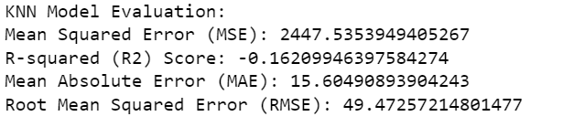
KNN Regression Performance with 100 Rows
Model Training with 100 Rows:
In this scenario, the model learns from a smaller sample of data, so the predictions might be less accurate and more sensitive to noise or outliers.
Metrics used to evaluate performance:
Mean Squared Error (MSE): Measures the average squared difference between predicted and actual values. A high MSE indicates poor model accuracy.
R-squared (R²) Score: Indicates how well the model explains the variance in the data. A high R² (close to 1) means the model is doing well.
MSE: Likely to be higher due to the smaller dataset.
R²: May be lower, indicating the model struggles to capture the underlying pattern accurately.
Impact of Increasing Dataset Size to 1000 Rows
Training with 1000 Rows:
With a larger dataset, the model has access to more information, which helps it better understand the underlying patterns in the data.
Larger datasets reduce the risk of overfitting to noise, making the model more robust and capable of generalizing well to unseen data.

Slide 9
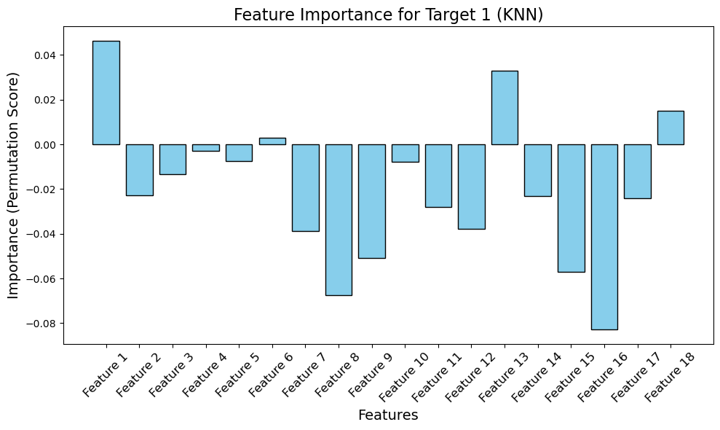
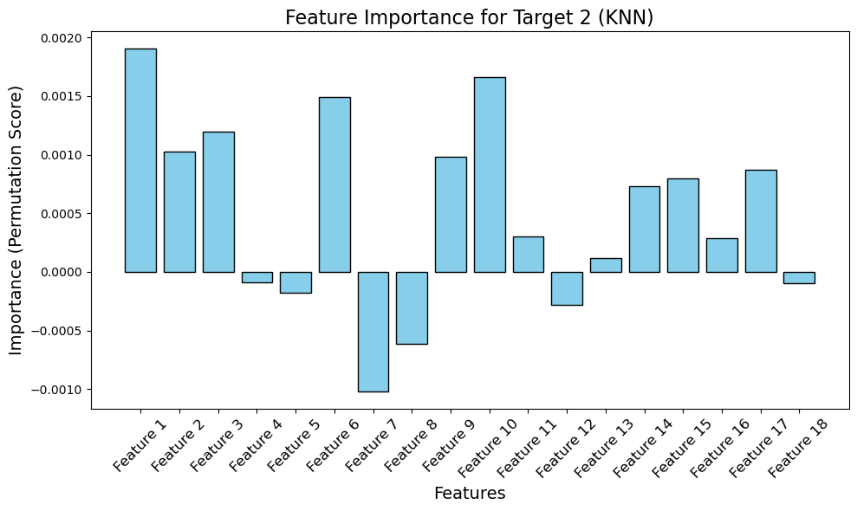
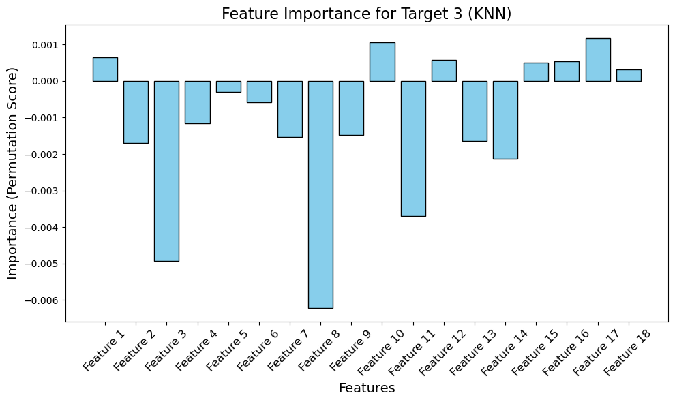
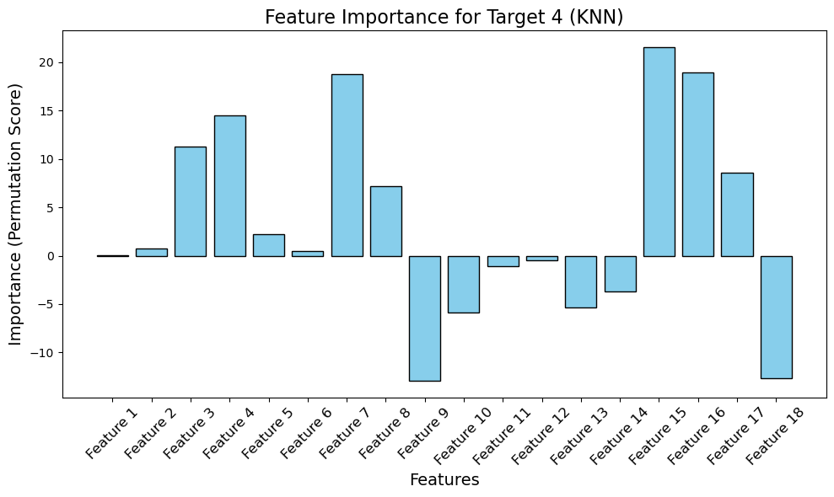
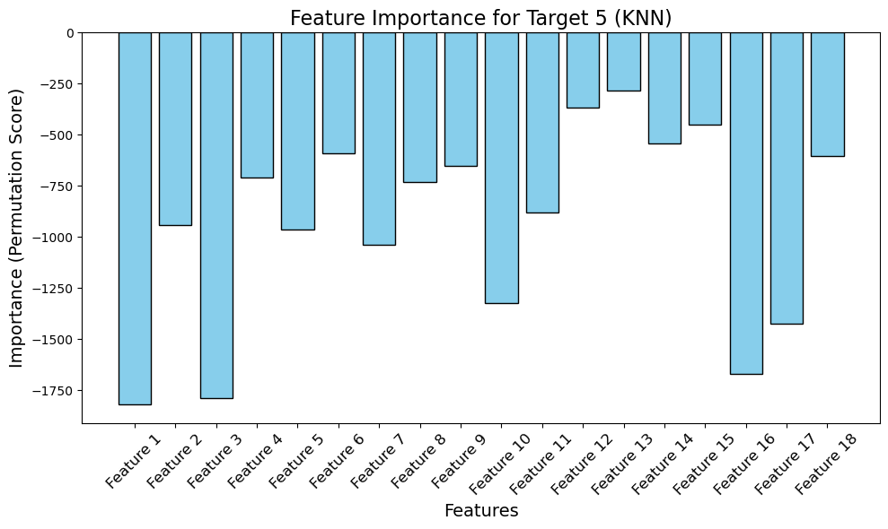
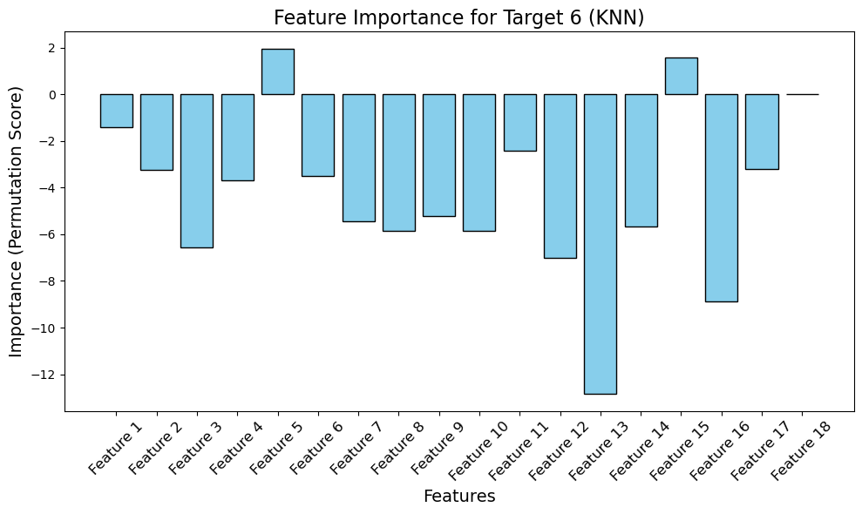
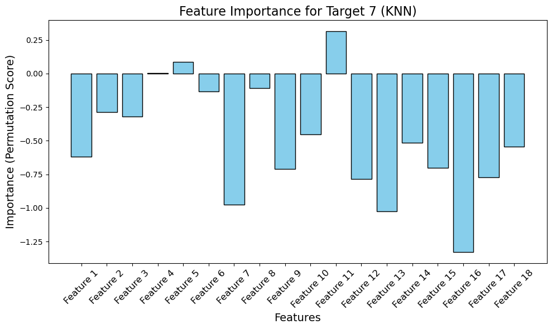

Slide 10
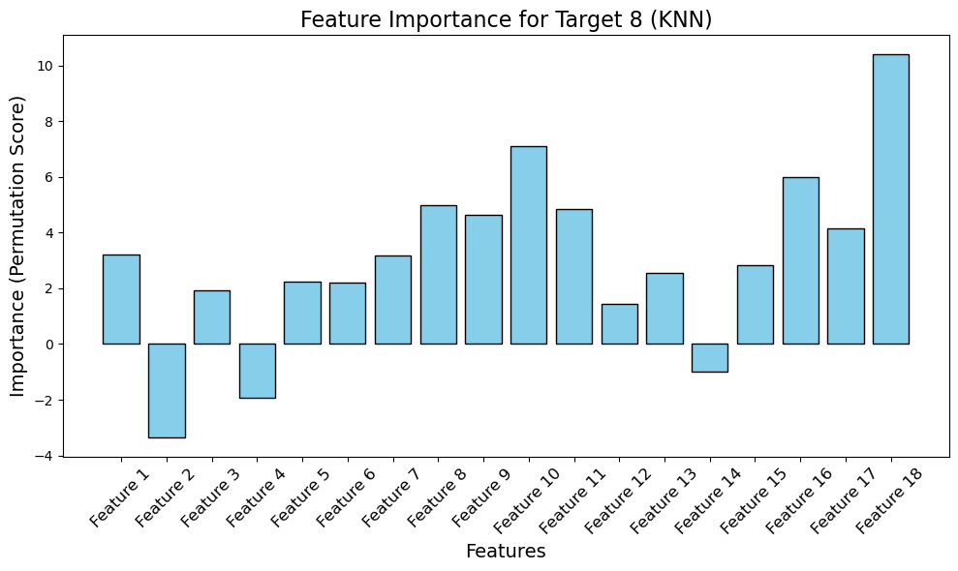
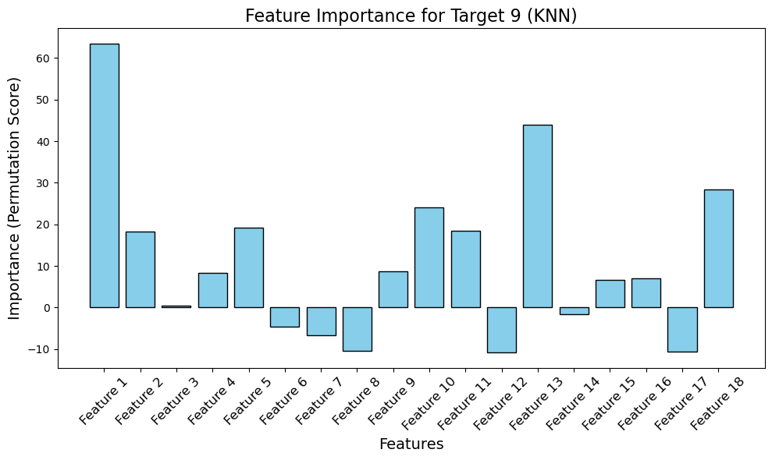
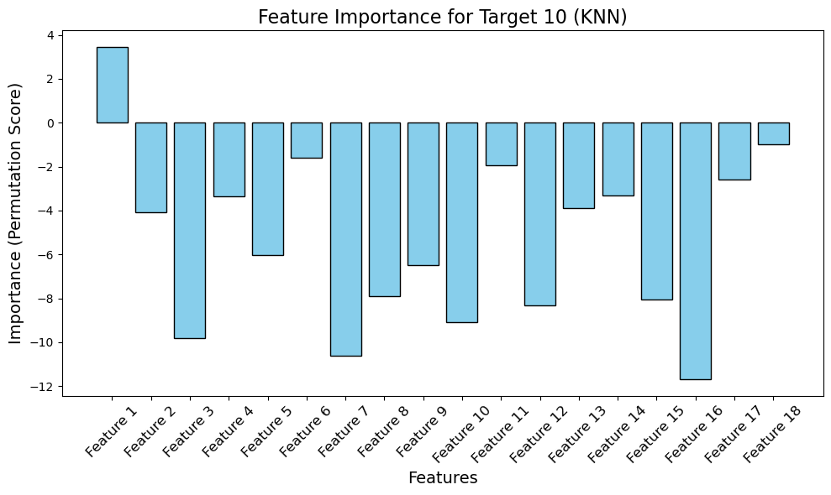
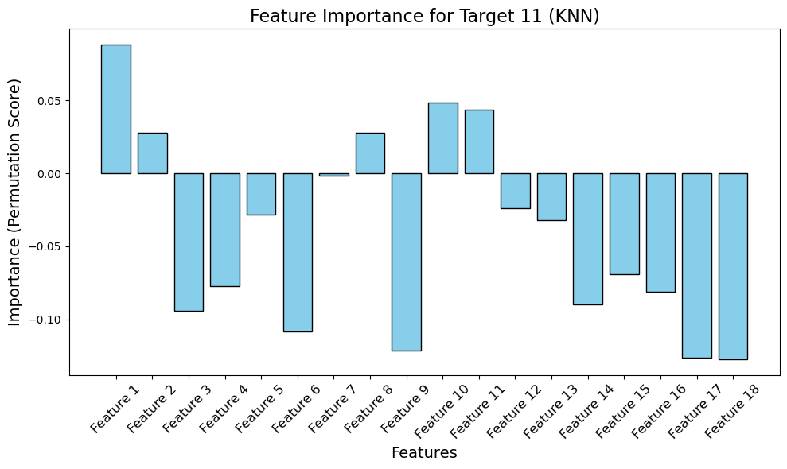
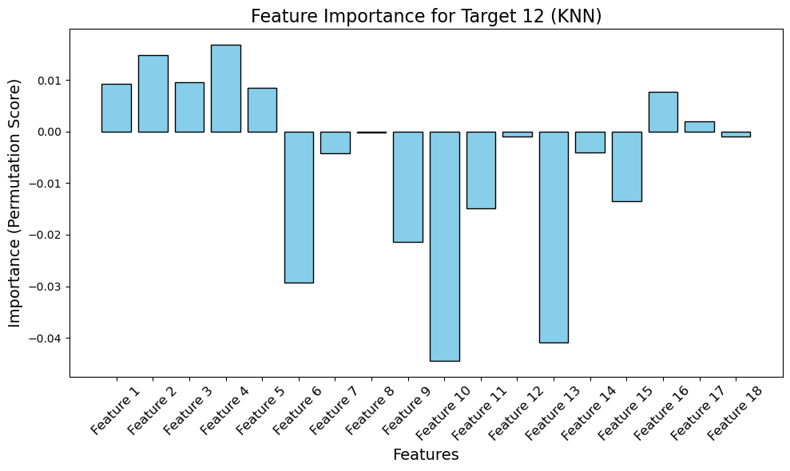
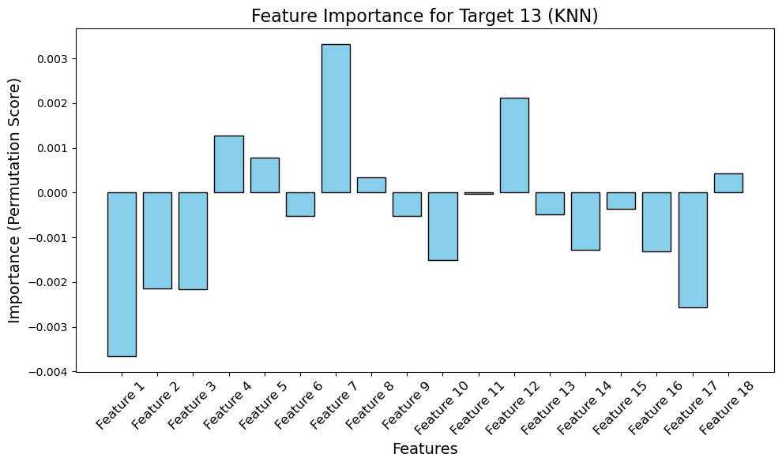

Slide 11
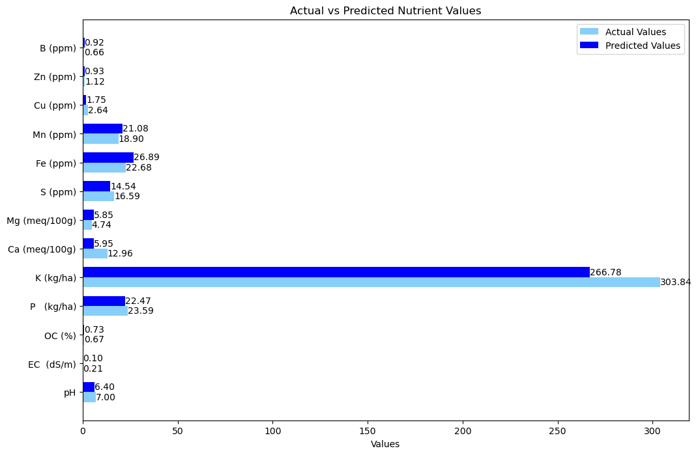
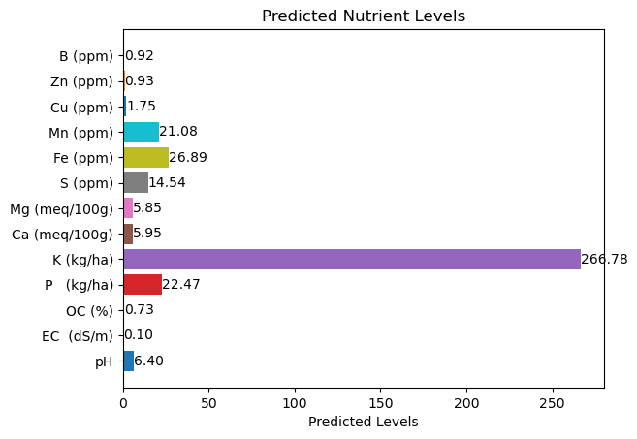

Slide 12
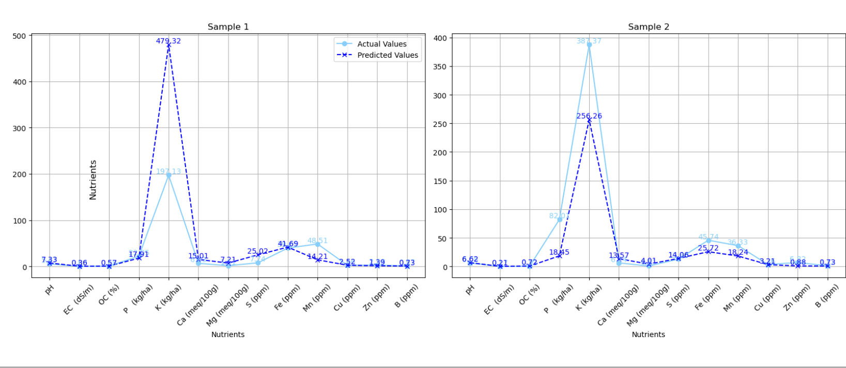
Actual vs Predicted levels for 5 samples.

Slide 13
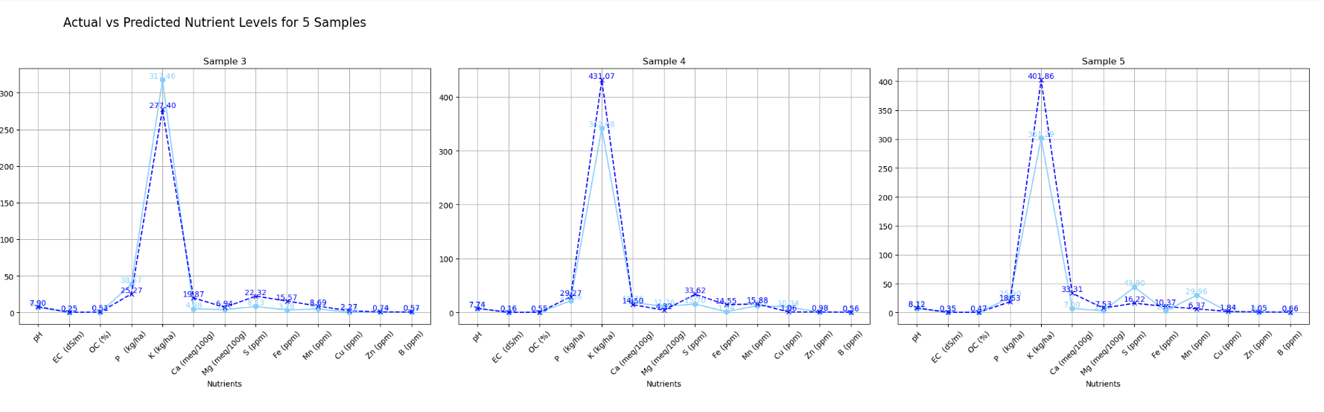

Slide 14
Random Forest Regressor on 100 samples dataset
Introduction to Random Forest Regressor (RFR)
Definition: Random Forest Regressor (RFR) is an ensemble learning method that uses multiple decision trees to make predictions. It combines predictions from these trees to improve accuracy and robustness.
Key Features:
Handles both regression and classification problems.
Reduces overfitting by averaging multiple models.
Handles large feature spaces and complex relationships in data.
Advantages:
Handles missing data and categorical variables well.
Robust to noise and outliers.
Provides feature importance scores, aiding feature selection.

Slide 15
Training Process Overview (100 vs. 1000 Rows)
Dataset Overview:
100 Rows: Small dataset, challenging for generalization.
1000 Rows: Larger dataset improves learning and reduces model variance.
Preprocessing:
Used Robust Scaler to handle outliers and scale data efficiently.
Steps:
Hyperparameter Tuning:
Explored parameters like the number of trees (n_estimators), maximum depth (max_depth), and minimum samples per split (min_samples_split).
Achieved optimal performance using GridSearchCV or RandomizedSearchCV.
Feature Selection:
Ranked features by importance using the model's inherent capabilities.
Retained the top features contributing to target prediction accuracy.

Slide 16
Evaluation Metrics and Results
100 Rows:
MSE (Mean Squared Error): Higher due to limited training data.
R² Score: Lower, indicating reduced ability to explain variance in the target.
1000 Rows:
MSE: Significantly lower, reflecting improved predictions.
R² Score: Higher, showing better variance explanation.
Trade-Offs:
Larger datasets require more computational power and time for training.
However, they enhance model generalization, reducing overfitting and increasing reliability.
Observations and Conclusions
Key Observations:
Increasing dataset size substantially improved performance metrics.
Feature selection helped focus on critical variables, streamlining the model.
Trade-Off Analysis:
Small Dataset (100 Rows): Quick to train but prone to overfitting and unreliable predictions.
Larger Dataset (1000 Rows): Requires more resources but yields accurate and robust models.
Conclusion:
Training RFR on a well-preprocessed and sufficiently large dataset leads to a balanced and high-performing model.
The combination of robust preprocessing, feature selection, and larger datasets is key to effective model training.

Slide 17
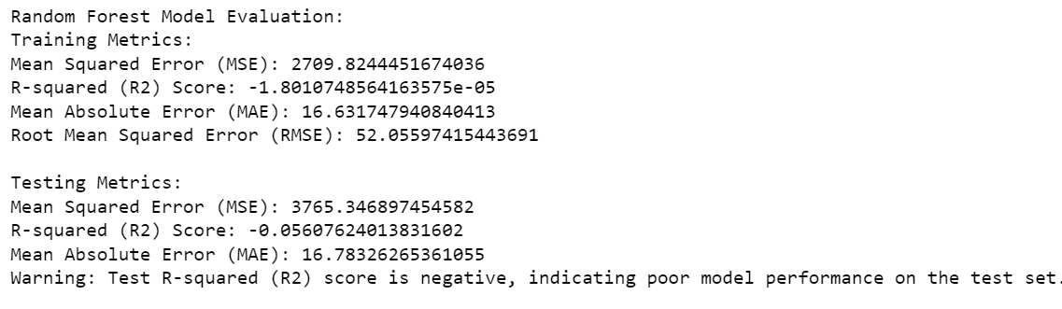

Slide 18
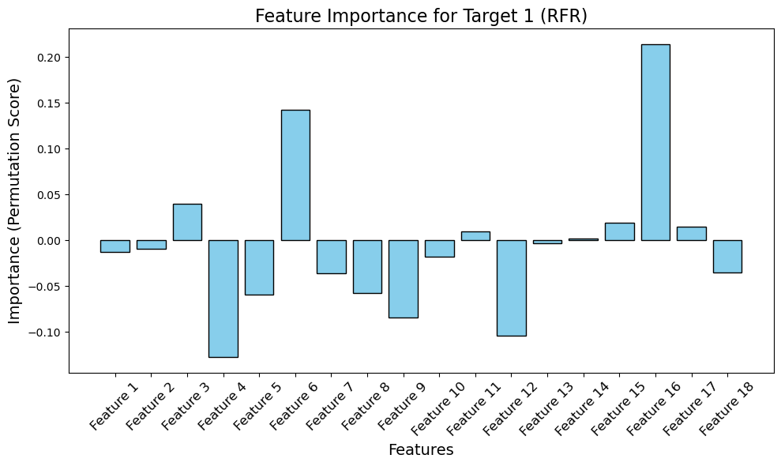
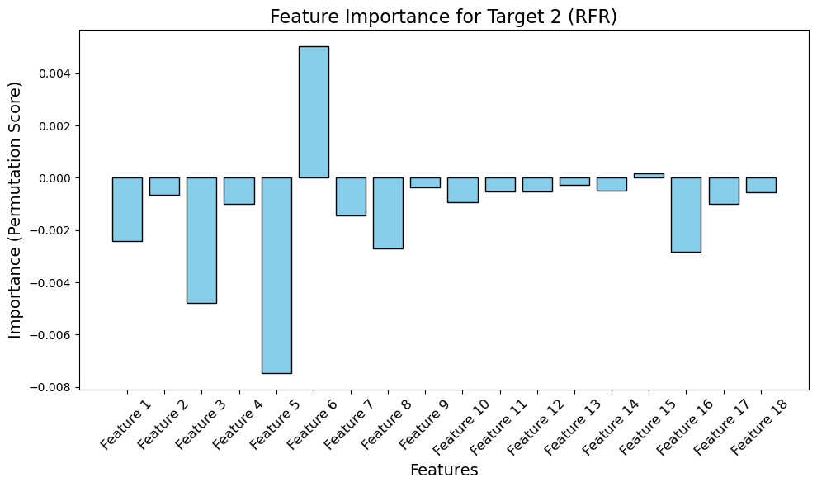
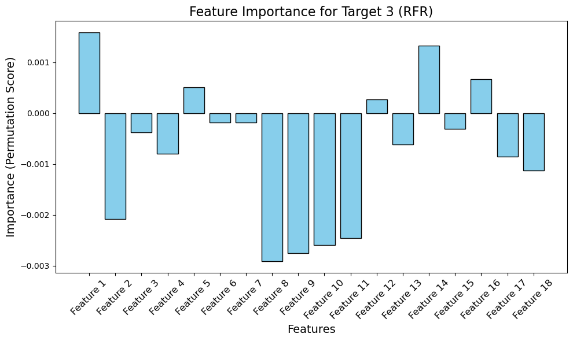
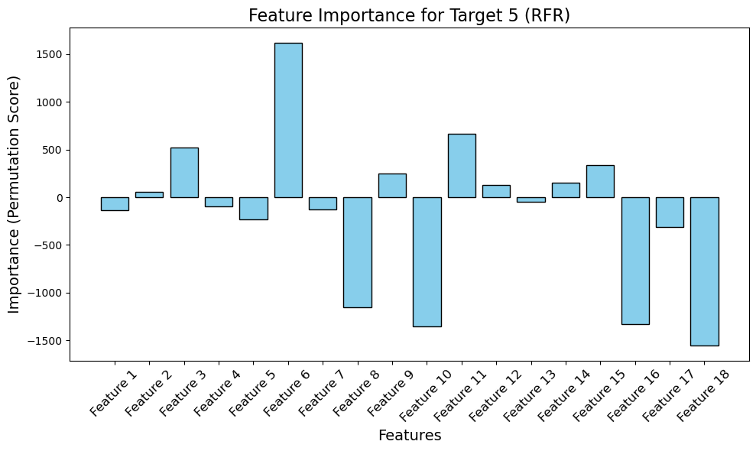
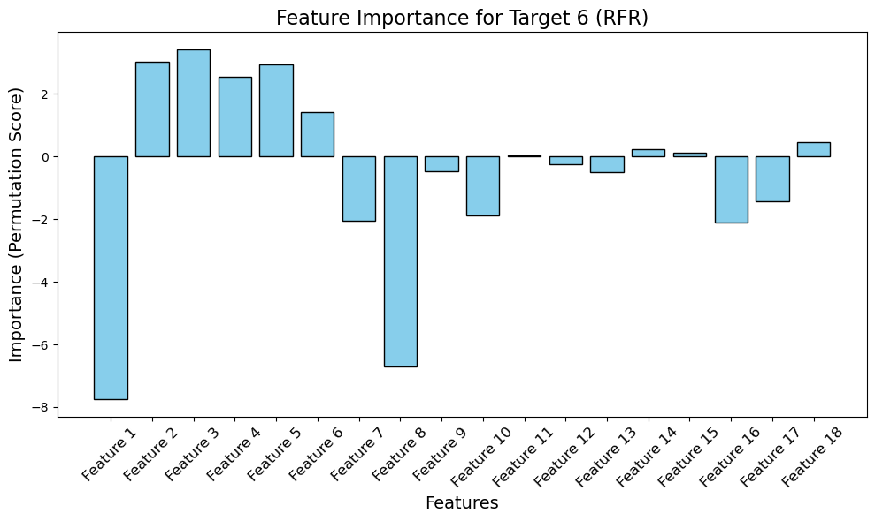
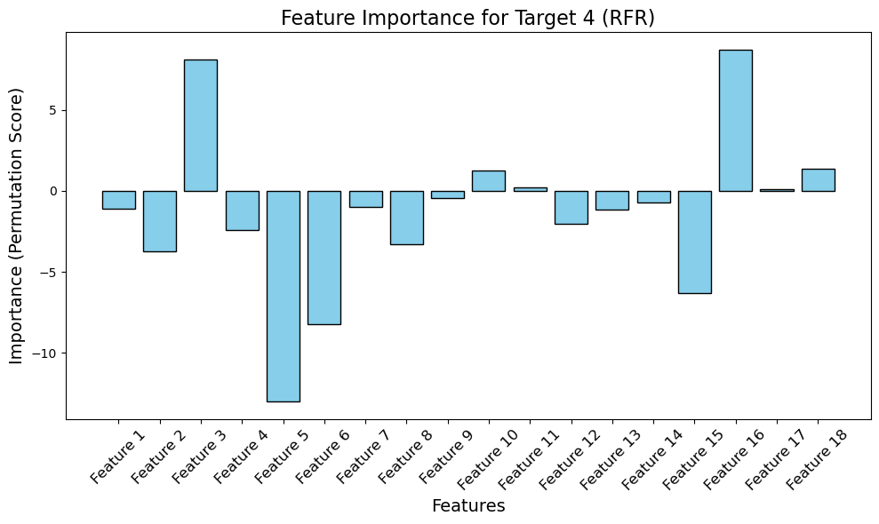
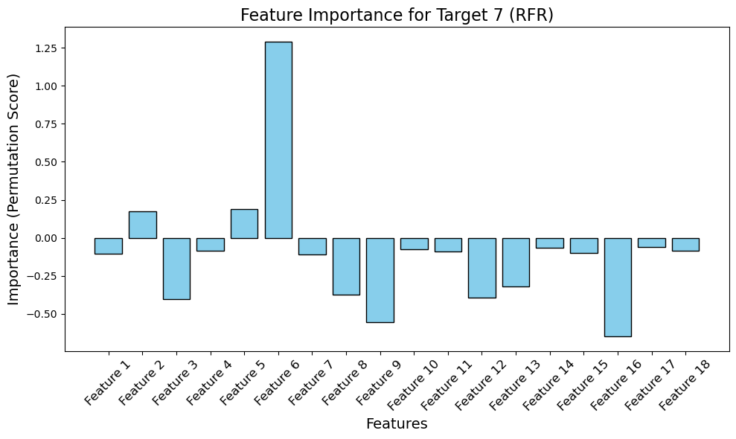

Slide 19
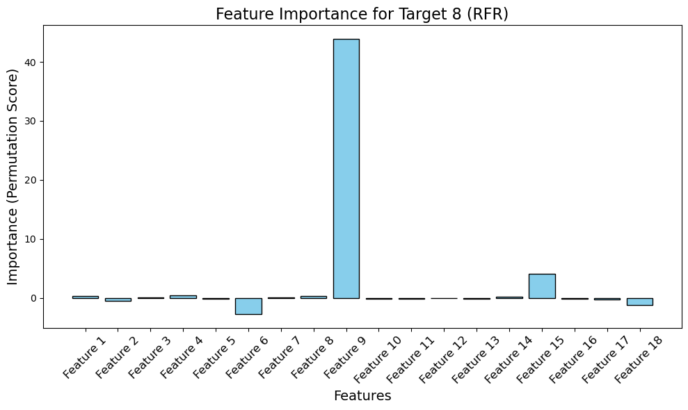
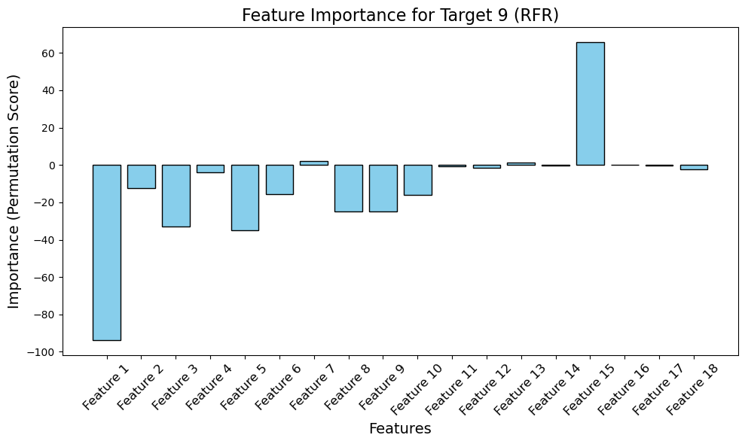
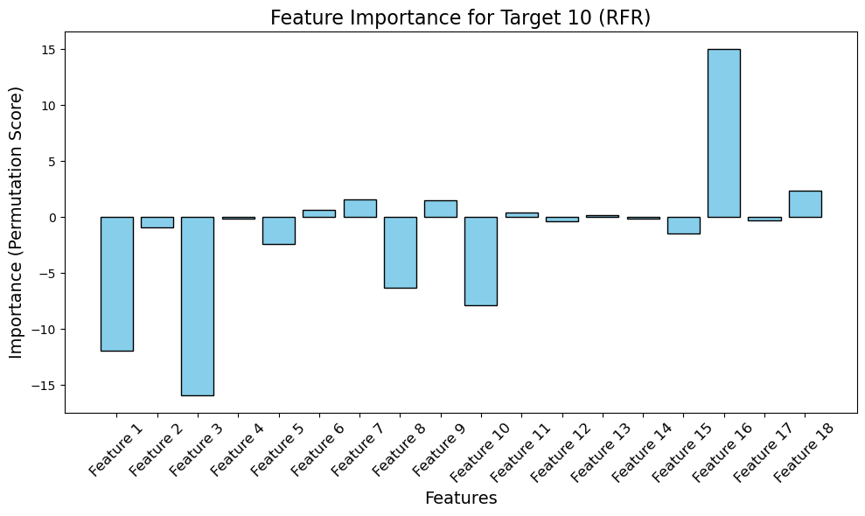
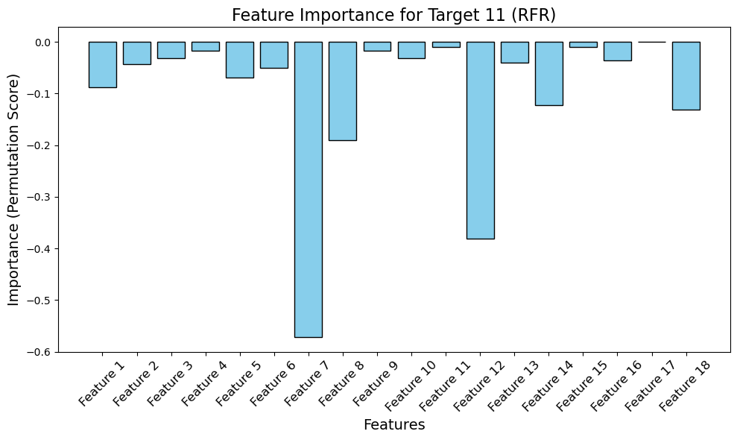
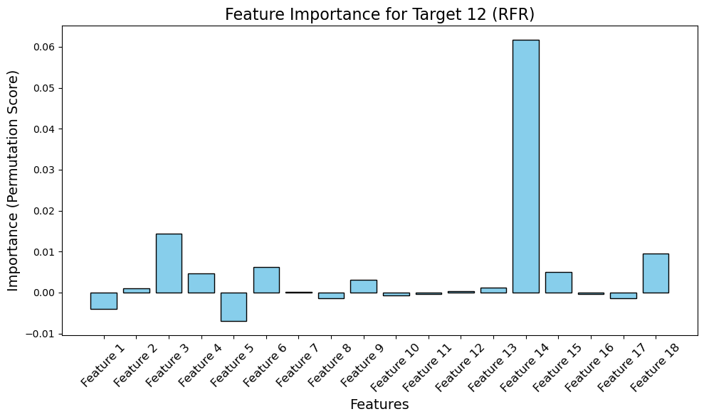
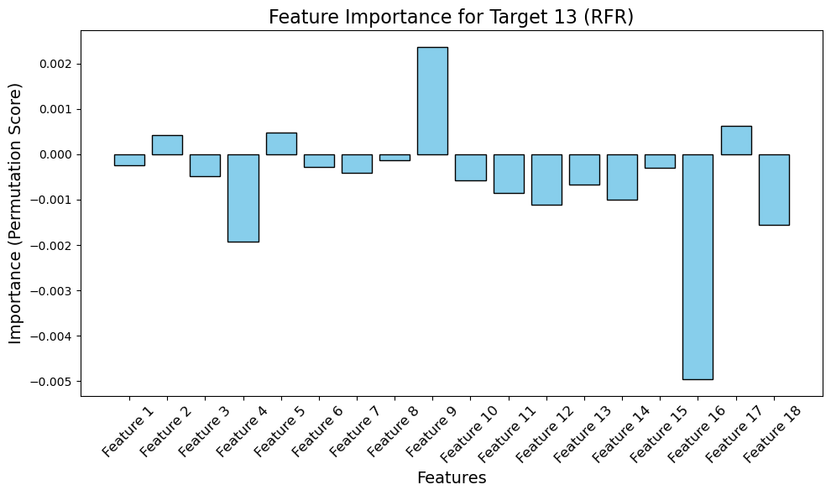

Slide 20
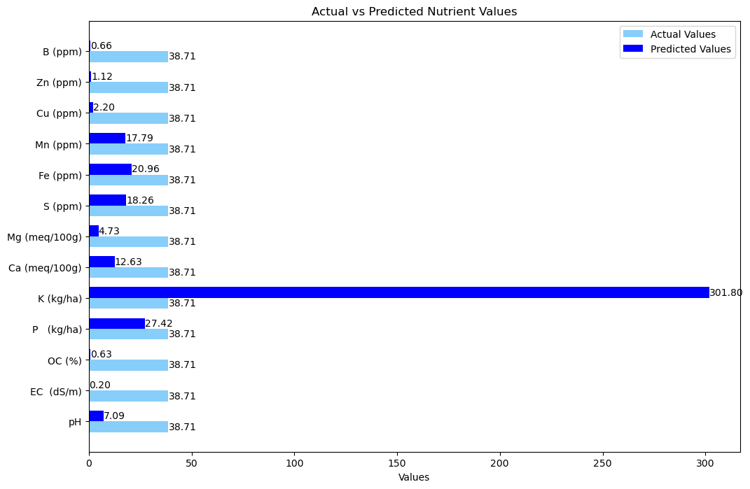
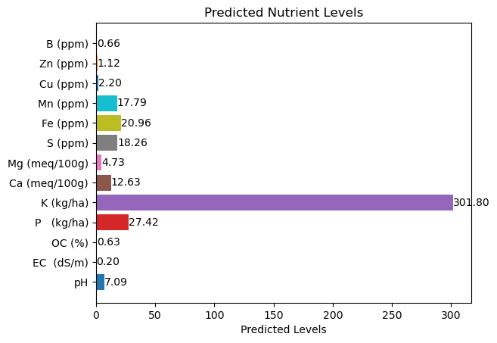

Slide 21
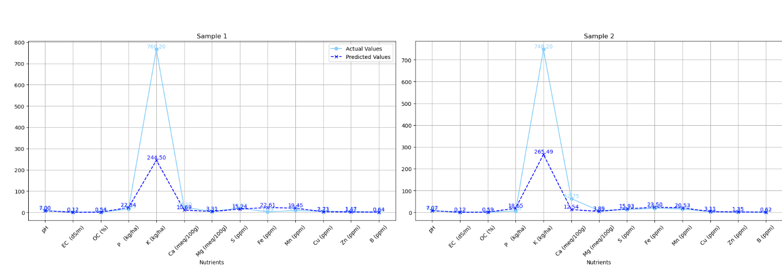
Actual vs Predicted levels for 5 samples.

Slide 22
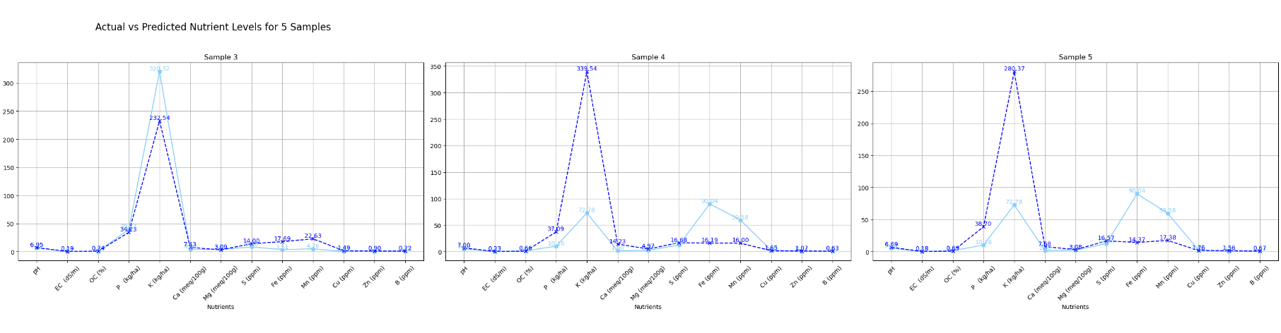

Slide 23
Gaussian Process Regressor on 100 rows dataset
Training a GPR Model on a 100-Row Dataset
Data Preprocessing
Handling Missing Values: Used SimpleImputer to replace missing values with the median of each feature, ensuring data consistency.
Feature Scaling: Applied RobustScaler to make the data robust to outliers by scaling based on the median and interquartile range (IQR).
Gaussian Process Regression (GPR):
A non-parametric, kernel-based model that predicts the mean and variance of the target variable.
Suitable for small datasets due to its ability to capture complex patterns with uncertainty estimation.

Slide 24
Hyperparameter Tuning and Feature Importance
Hyperparameter Tuning:
Performed a grid search or Bayesian optimization to identify the best combination of kernel functions and hyperparameters for GPR.
Key hyperparameters: kernel choice, length scale, and noise level.
Used cross-validation to evaluate model performance during tuning.
Permutation Importance for Feature Importance Visualization:
Evaluated the impact of each feature by randomly permuting its values and observing the effect on model performance.
Identified the most influential features, providing insights into the dataset's structure.

Slide 25
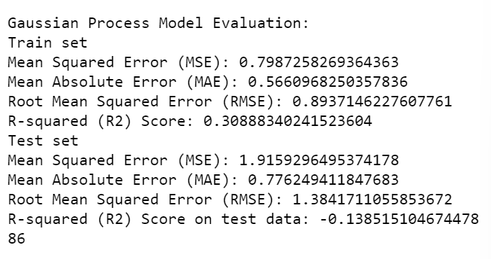
Model Evaluation
Evaluation Metrics:
Mean Squared Error (MSE): Measures the average squared differences between predicted and actual values. Lower is better.
Mean Absolute Error (MAE): Reflects the average magnitude of prediction errors.
R² Score: Indicates the proportion of variance in the target variable explained by the model. Values closer to 1 suggest a better fit.
Results on 100 Rows:
Performance is generally good, but GPR may overfit due to the small dataset size.
Limited data can cause variability in metrics, making the model sensitive to outliers and noise.

Slide 26
Trade-offs When Using 1000 Rows
Advantages of Larger Dataset:
Improved Generalization: GPR can learn more robust patterns, reducing overfitting.
Better Metrics: MSE and R² scores improve due to the availability of diverse samples.
Challenges with Larger Dataset:
Computational Complexity: GPR scales poorly with dataset size (O(n³) complexity), making training slow and resource-intensive.
Memory Usage: Large datasets can strain memory resources, requiring approximations like sparse GPR.
Trade-off Example:
100 Rows: Fast training, but the model might underperform on unseen data due to insufficient variability.
1000 Rows: Better generalization and performance metrics (lower MSE, higher R²), but at the cost of computational efficiency.

Slide 27
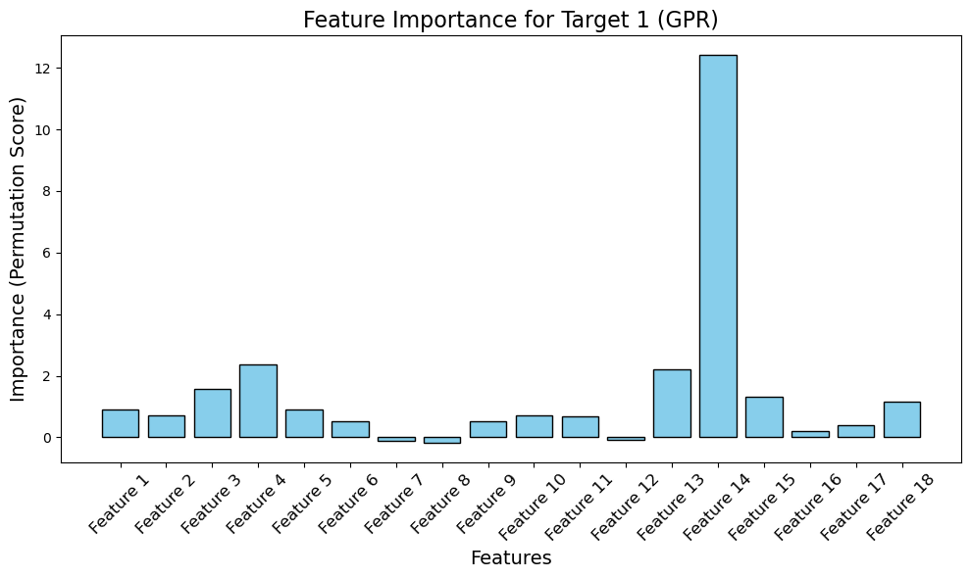
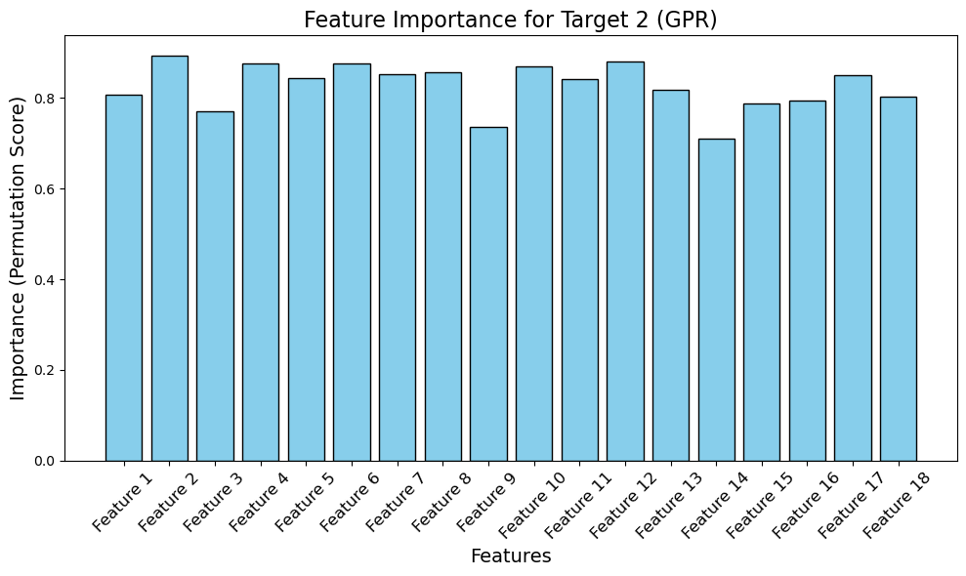
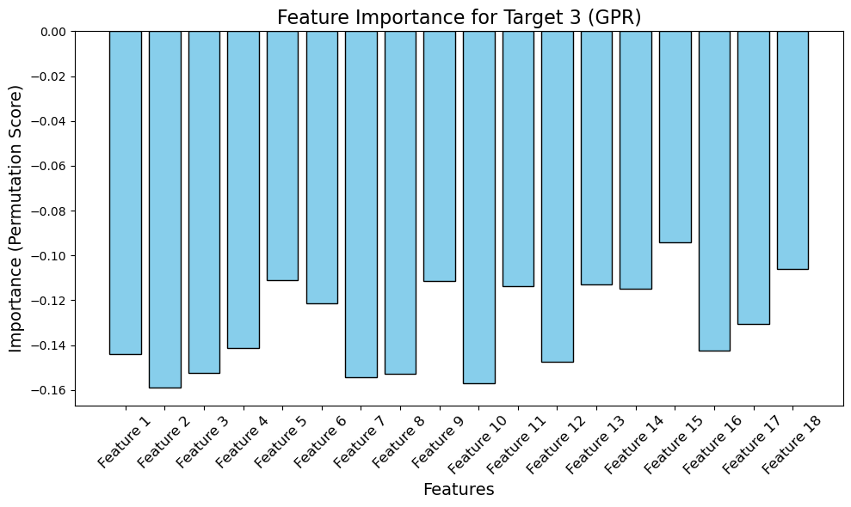
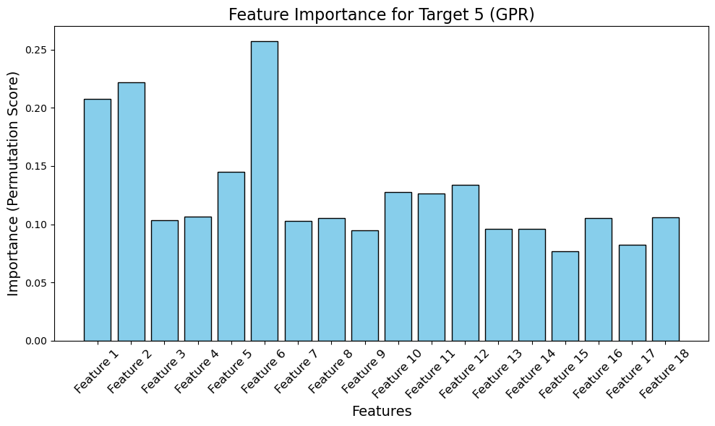
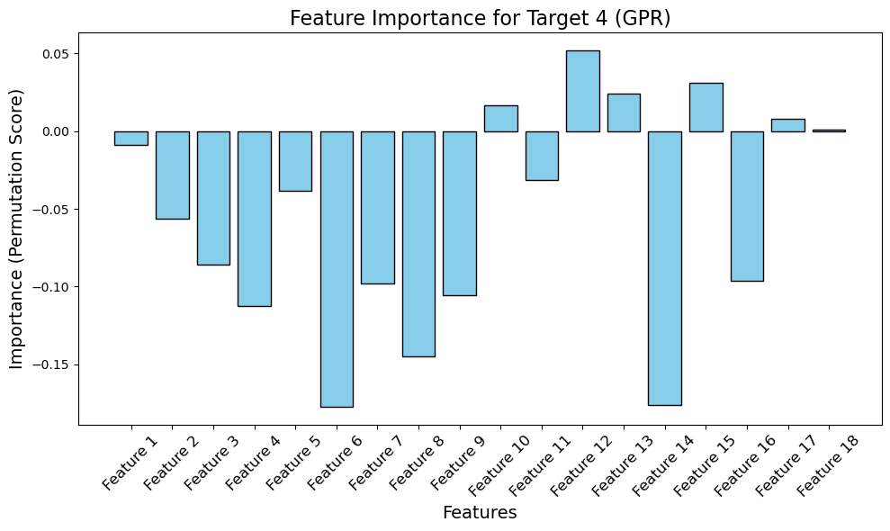
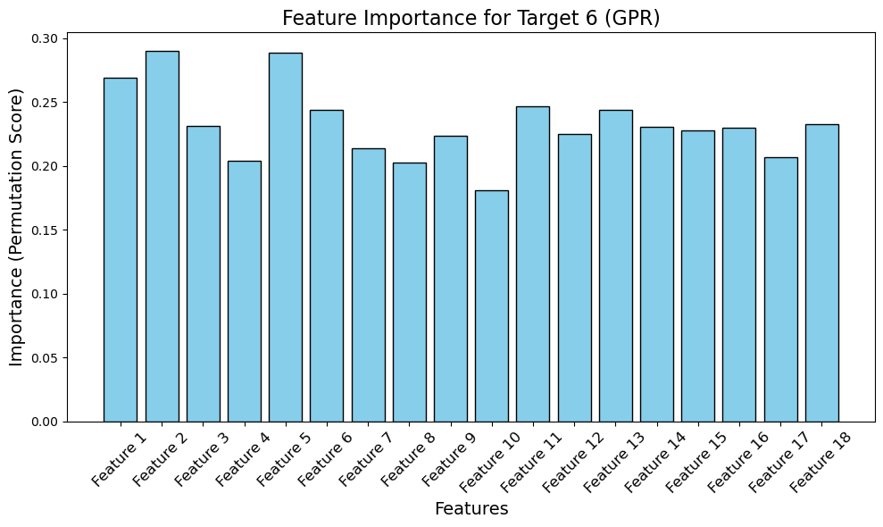
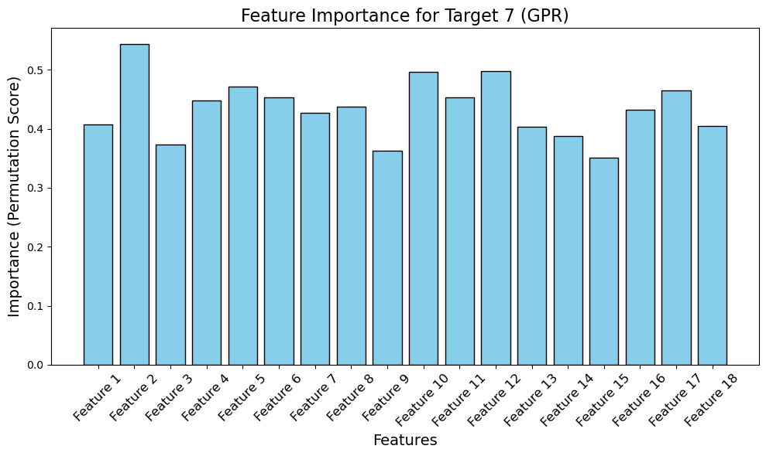

Slide 28
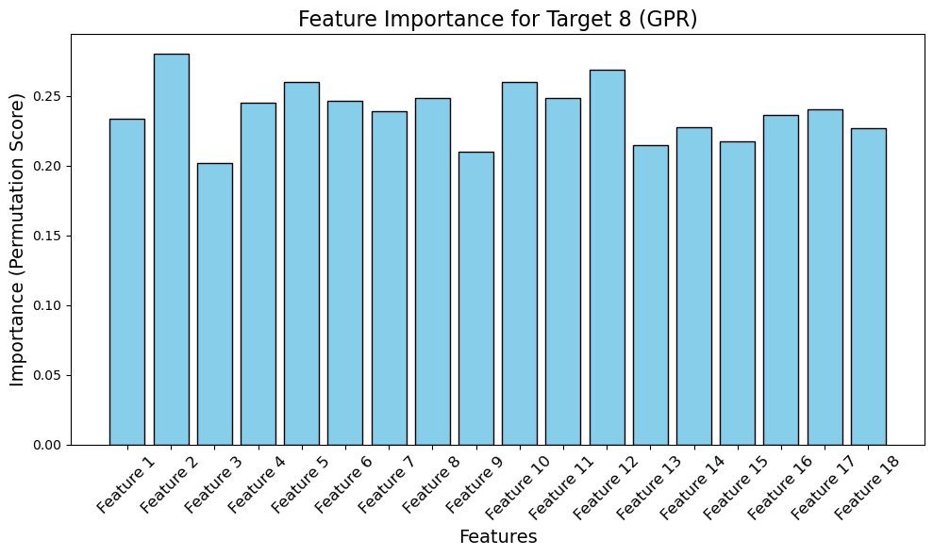
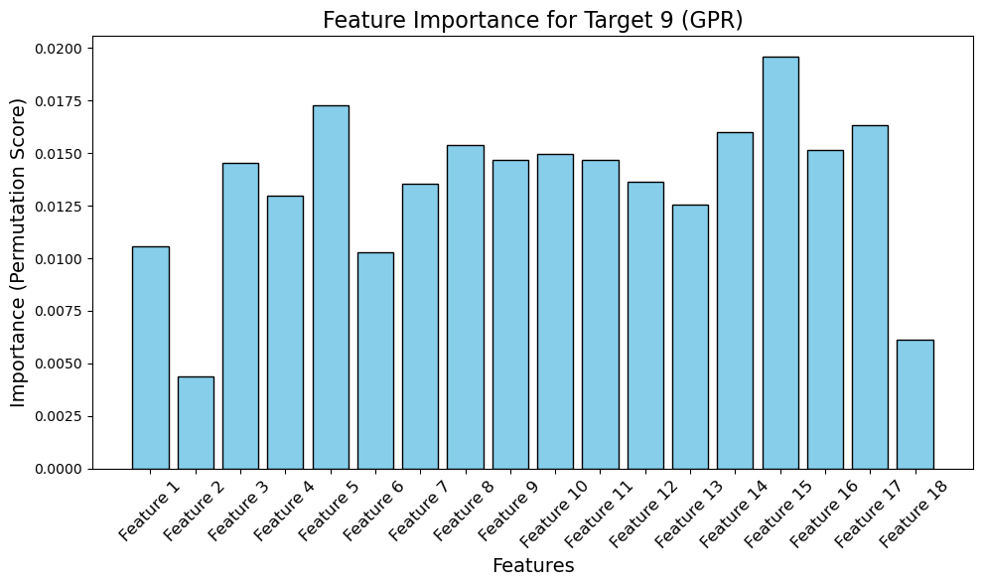
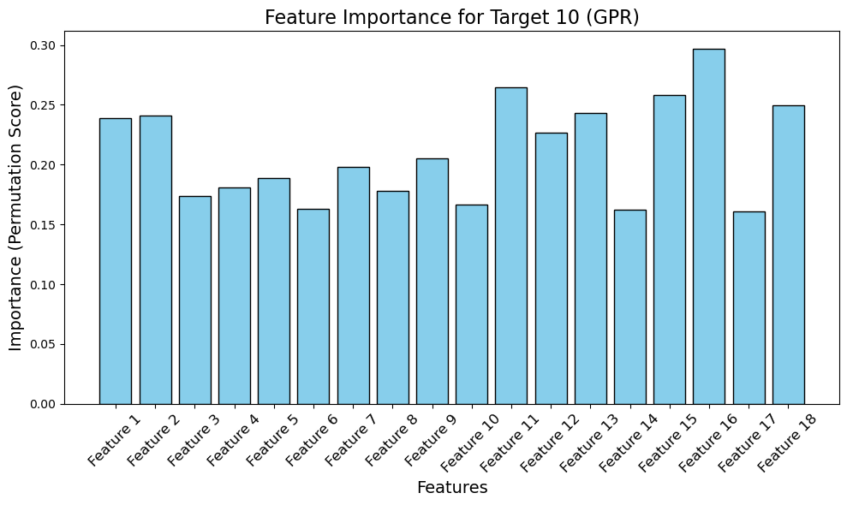
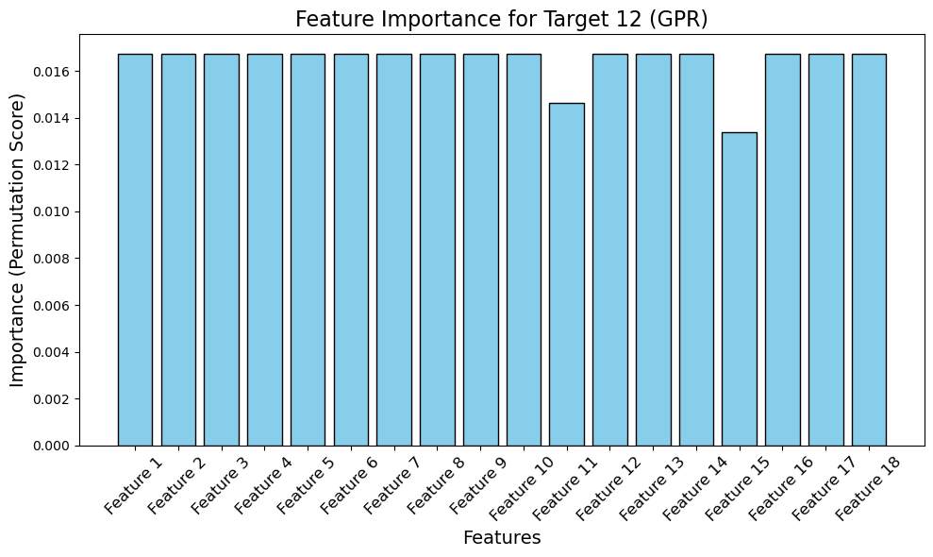
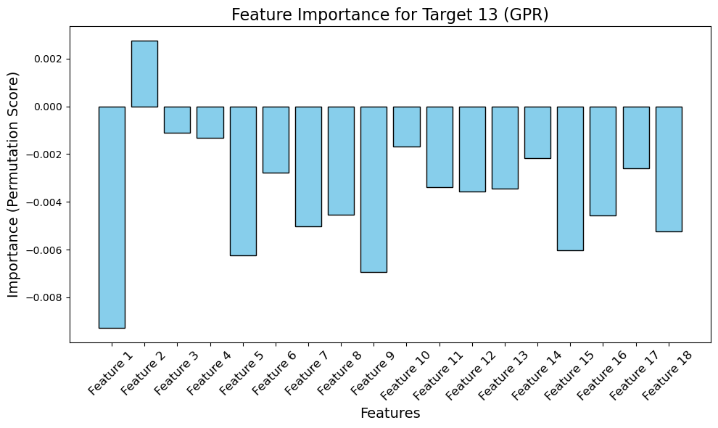
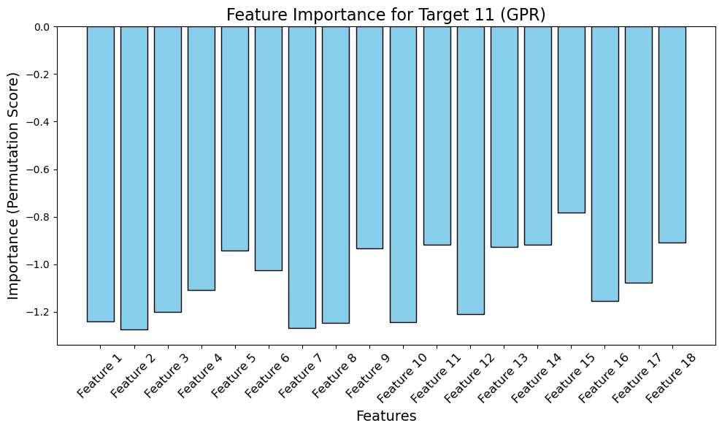

Slide 29



Slide 30

Actual vs Predicted level for 5 samples.

Slide 31


Slide 32

DATA INTERPOLATION
Interpolation is a mathematical method used to estimate unknown values that fall between known data points. It is commonly used in various fields like data science, engineering, computer graphics, and signal processing to create smooth transitions or fill in missing data. Here's a more detailed exploration of interpolation. nterpolation is primarily used when you have a set of discrete data points, and you want to estimate the values between them. This is particularly useful when:
You have missing data.
You want to resample data to a finer resolution.
You want to smooth out noisy data.
You need to fill in gaps in time-series data or signals.

Slide 33
LINEAR INTERPOLATION
LINEAR INTERPOLATION IS IDEAL FOR SITUATIONS WHERE THE DATA IS ASSUMED TO CHANGE CONSISTENTLY BETWEEN TWO POINTS. IT CREATES A SMOOTH, STRAIGHT PATH BETWEEN CONSECUTIVE DATA POINTS, MAKING IT USEFUL FOR FILLING IN MISSING VALUES OR INCREASING THE RESOLUTION OF THE DATA. IN THE CONTEXT OF THIS CODE, IT HELPS GENERATE A FINER DATASET BY ESTIMATING THE VALUES THAT LIE BETWEEN THE ORIGINAL DATA POINTS, ENSURING THAT THE TRANSITIONS REMAIN GRADUAL AND CONTINUOUS. SINCE IT ONLY REQUIRES THE NEAREST TWO DATA POINTS TO MAKE PREDICTIONS, LINEAR INTERPOLATION IS BOTH SIMPLE AND COMPUTATIONALLY EFFICIENT, MAKING IT A POPULAR CHOICE WHEN WORKING WITH DATASETS THAT ARE RELATIVELY SMOOTH OR HAVE SMALL GAPS. THIS APPROACH PROVIDES A BALANCED WAY TO MAINTAIN THE INTEGRITY OF THE ORIGINAL DATA WHILE ADDING MORE DETAIL OR FILLING IN GAPS.

Slide 34






features
target values
INITIALLY WE HAD A 100 ROWS DATASET. ON IMPLEMENTING DATA INTEROLATION ALGORITHM WE INCRESED THE DATASET TO 1000 ROWS. THE METRICS TURNED OUT TO BE MUCH BETTER WITH RESPECT TO THE NEW DATASET. THE MODEL PERFORMANCE INCREASED. ALL THE MODELS ARE TRAINED ON THE NEW DATASET.

Slide 35
K NEAREST NEIGHBORS REGRESSOR
K-nearest neighbors (KNN) regression is a machine learning technique that uses the proximity of data points to make predictions about a new data point:
How it works- KNN regression stores training samples and calculates the distance to each new data point to find the k closest neighbors. The output is the average of the values of the k nearest neighbors.
When to use it- KNN regression is a simple yet effective method that's often used in text mining, facial recognition, and recommendation systems. It's also valued for its ability to handle complex structured data, especially big data.
Calculating distance- There are several methods for calculating the distance between points, including Euclidean, Manhattan, and Cosine.

Slide 36
Selecting optimum value of k
SELECTING THE BEST VALUE OF K IN K-NEAREST NEIGHBORS (KNN) IS CRUCIAL BECAUSE IT DIRECTLY INFLUENCES THE MODEL'S PERFORMANCE AND PREDICTION ACCURACY. THE K VALUE DETERMINES THE NUMBER OF NEIGHBORS CONSIDERED WHEN MAKING PREDICTIONS. IF K IS TOO SMALL (E.G., K=1), THE MODEL BECOMES HIGHLY SENSITIVE TO NOISE AND OUTLIERS, AS IT ONLY CONSIDERS THE CLOSEST NEIGHBOR, WHICH MIGHT NOT REPRESENT THE BROADER PATTERN IN THE DATA. THIS CAN LEAD TO OVERFITTING, WHERE THE MODEL MEMORIZES SPECIFIC POINTS BUT FAILS TO GENERALIZE TO NEW DATA. ON THE OTHER HAND, IF K IS TOO LARGE (E.G K=50), THE MODEL MAY BECOME TOO SIMPLISTIC BY AVERAGING TOO MANY NEIGHBORS, INCLUDING POTENTIALLY IRRELEVANT OR DISTANT ONES. THIS CAN RESULT IN UNDERFITTING, WHERE THE MODEL FAILS TO CAPTURE IMPORTANT LOCAL VARIATIONS. THEREFORE, SELECTING THE OPTIMAL K VALUE ENSURES A GOOD BALANCE BETWEEN BIAS AND VARIANCE, LEADING TO MORE ACCURATE AND GENERALIZABLE PREDICTIONS.

Slide 37
PROCEDURE
Given the characteristics of your dataset (1000 rows, 18 features, and hyperspectral data), KD-trees work well for datasets with moderate dimensions (like 18 features), and with 1000 rows, this method should provide a fast and efficient search.
The task involves building a K-Nearest Neighbors (KNN) regression model to predict soil organic matter using a dataset with 1000 rows, 18 features, and 13 target values derived from hyperspectral data.
The goal is to optimize the model by selecting the best value of k (number of neighbors) and the appropriate distance metric through GridSearchCV.
By defining a parameter grid, which includes different values of k and metrics (such as Euclidean, Manhattan, and Cosine distances), a cross-validated search is performed to identify the parameter combination that minimizes the mean squared error (MSE).
The result is a model that balances sensitivity to local data patterns without overfitting or underfitting, ensuring accurate predictions of soil organic matter.

Slide 38



Slide 39





Slide 40





Slide 41





Slide 42


Slide 43


ACTUAL AND PREDICTED VALUES

Slide 44

Actual vs Predicted for 5 samples.

Slide 45


Slide 46
RONDOM FOREST REGRESSOR
When monitoring land surface information using remote sensing, RF is an algorithm that can quantitatively analyze ground-based information. RF, which integrates the advantages of a decision tree and bagging set, introduces randomly selected features into model training [54]. Using RF to train the models not only effectively avoids overfitting, but also restrains the negative effects of noise. This improves the accuracy and stability of model classification and prediction. In addition, RF is able to process and analyze high-dimensional information features, and statistically analyze the importance of multi-dimensional features, which is conducive to the comprehensive use of the hyperspectral characteristics of ground?based objects. Since the number of decision trees has a great influence on a model, the number of decision trees was set as 100 in this study to guarantee the stability of each model

Slide 47
RANDOM FOREST IS AN ENSEMBLE LEARNING METHOD PRIMARILY USED FOR REGRESSION AND CLASSIFICATION TASKS. IT BUILDS MULTIPLE DECISION TREES DURING TRAINING AND OUTPUTS THE AVERAGE OF THE PREDICTIONS FROM THESE TREES (IN THE CASE OF REGRESSION). IT IS A POWERFUL AND FLEXIBLE MODEL THAT WORKS WELL IN VARIOUS SCENARIOS, ESPECIALLY WHEN THE RELATIONSHIP BETWEEN FEATURES AND THE TARGET VARIABLE IS COMPLEX AND NON-LINEAR
KEY CONCEPTS OF RANDOM FOREST REGRESSOR
DECISION TREES: EACH DECISION TREE IS CONSTRUCTED BY RECURSIVELY SPLITTING THE DATASET INTO SUBSETS BASED ON FEATURE VALUES THAT MAXIMIZE THE VARIANCE REDUCTION AT EACH NODE (FOR REGRESSION). DECISION TREES, HOWEVER, TEND TO OVERFIT THE DATA.
BAGGING (BOOTSTRAP AGGREGATING): RANDOM FOREST IMPROVES THE DECISION TREE'S PERFORMANCE THROUGH BAGGING, WHERE MULTIPLE TREES ARE BUILT ON RANDOM SUBSETS OF THE DATA, AND THE FINAL PREDICTION IS THE AVERAGE OF ALL THE TREES' PREDICTIONS. THIS REDUCES OVERFITTING AND INCREASES THE MODEL’S GENERALIZATION ABILITY.
FEATURE SAMPLING: IN ADDITION TO BAGGING, RANDOM FOREST INTRODUCES ANOTHER LAYER OF RANDOMNESS BY SELECTING A RANDOM SUBSET OF FEATURES AT EACH SPLIT IN THE TREE CONSTRUCTION PROCESS. THIS PREVENTS ANY SINGLE FEATURE FROM DOMINATING THE MODEL AND ENHANCES DIVERSITY AMONG THE TREES.

Slide 48
DATA PREPROCESSING FOR RANDOM FOREST: For optimal performance, data preprocessing is critical. In this case, we will use MinMaxScaler to normalize the feature set. Normalization helps in scaling the feature values within a specific range, typically [0, 1].
HYPERPARAMETER TUNING FOR RANDOM FOREST: THE PERFORMANCE OF RANDOM FOREST CAN BE IMPROVED BY TUNING ITS HYPERPARAMETERS. SOME KEY HYPERPARAMETERS INCLUDE:
N_ESTIMATORS: THE NUMBER OF TREES IN THE FOREST. INCREASING THIS TYPICALLY IMPROVES PERFORMANCE BUT ALSO INCREASES COMPUTATIONAL COST.
MAX_DEPTH: THE MAXIMUM DEPTH OF EACH TREE. LIMITING DEPTH HELPS PREVENT OVERFITTING.
MIN_SAMPLES_SPLIT: THE MINIMUM NUMBER OF SAMPLES REQUIRED TO SPLIT A NODE. HIGHER VALUES CAN PREVENT TREES FROM LEARNING OVERLY SPECIFIC PATTERNS IN THE DATA.
USING GRIDSEARCHCV HELPS FIND THE BEST COMBINATION OF THESE HYPERPARAMETERS BY EVALUATING DIFFERENT MODELS WITH CROSS-VALIDATION.

Slide 49
FEATURE IMPORTANCE IN RANDOM FOREST: ONE OF THE SIGNIFICANT ADVANTAGES OF RANDOM FOREST IS THAT IT COMPUTES FEATURE IMPORTANCE. IT ESTIMATES HOW IMPORTANT EACH FEATURE IS FOR PREDICTING THE TARGET VARIABLE BY CALCULATING HOW MUCH EACH FEATURE REDUCES THE ERROR ACROSS ALL THE TREES.
Model Training and Prediction: After identifying the best hyperparameters through GridSearchCV, the model is retrained on the full training dataset. Once trained, the model can be used to make predictions on the test set.
EVALUATION METRICS: For regression tasks, the following evaluation metrics are commonly used:
Mean Squared Error (MSE): Measures the average of the squares of the errors or deviations frOM THE ACTUAL TARGET VALUES.
R-SQUARED (R²): MEASURES THE PROPORTION OF VARIANCE IN THE TARGET VARIABLE THAT IS PREDICTABLE FROM THE FEATURES. AN R² VALUE CLOSER TO 1 INDICATES BETTER PERFORMANCE.

Slide 50
CONCLUSION:
RANDOM FOREST IS A POWERFUL AND FLEXIBLE MODEL FOR REGRESSION TASKS. BY LEVERAGING AN ENSEMBLE OF DECISION TREES, IT REDUCES OVERFITTING, CAPTURES COMPLEX RELATIONSHIPS, AND PROVIDES USEFUL INSIGHTS INTO FEATURE IMPORTANCE. COMBINING MINMAXSCALER FOR DATA NORMALIZATION, GRIDSEARCHCV FOR HYPERPARAMETER TUNING, AND K-FOLD CROSS-VALIDATION FOR MODEL EVALUATION ENSURES THAT THE MODEL IS ROBUST AND GENERALIZES WELL TO NEW DATA. FINALLY, CALCULATING KEY EVALUATION METRICS LIKE MSE AND R-SQUARED HELPS ASSESS THE MODEL'S PERFORMANCE ON UNSEEN DATA.

Slide 51


FEATURE IMPORTANCE

Slide 52





Slide 53





Slide 54





Slide 55


Slide 56


MODEL EVALUATION METRICS
HYPERPARAMETER TUNING

Slide 57


PREDICTING THE TARGET VALUES
ON TRAIN DATA

Slide 58

Actual vs Predicted for 5 samples.

Slide 59


Slide 60
GAUSSIAN PROCESS REGRESSION
Gaussian Process Regression (GPR) is a flexible, non-parametric regression method that offers an approach to making predictions and quantifying uncertainty in those predictions. Unlike parametric models like linear regression, which assume a specific form for the function being modeled, GPR allows for more flexibility by placing a Gaussian distribution over possible functions, which can better adapt to the data’s complexity. Gaussian Process Regression is a powerful tool for regression tasks, particularly for smaller datasets with complex relationships. With hyperparameter tuning and cross-validation, GPR can achieve high accuracy while providing uncertainty estimates for predictions, which are essential for many real-world applications.

Slide 61
ADVANTAGES OF GPR
NON-PARAMETRIC NATURE: UNLIKE TRADITIONAL REGRESSION TECHNIQUES THAT FIT FIXED-FORM FUNCTIONS (E.G., LINEAR REGRESSION), GPR ADAPTS THE MODEL COMPLEXITY TO THE DATA.
UNCERTAINTY QUANTIFICATION: GPR GIVES UNCERTAINTY (VARIANCE) ALONG WITH THE PREDICTIONS, WHICH IS HELPFUL IN MANY REAL-WORLD PROBLEMS WHERE CONFIDENCE IN PREDICTIONS IS IMPORTANT.
FLEXIBILITY: BY CHOOSING APPROPRIATE KERNEL FUNCTIONS, GPR CAN MODEL A WIDE RANGE OF DATA PATTERNS, INCLUDING SMOOTH, PERIODIC, AND MORE COMPLEX RELATIONSHIPS.
WORKS WELL FOR SMALL DATASETS: GPR TYPICALLY PERFORMS WELL ON SMALL TO MEDIUM-SIZED DATASETS WHERE IT CAN CAPTURE THE UNDERLYING DATA STRUCTURE EFFECTIVELY.

Slide 62



TRAGET VALUES TO BE PREDICTED
FEATURES ON WHICH THE MODEL IS TRAINED

Slide 63
By following these steps, Gaussian Process Regression can be effectively applied to your spectroscopic dataset, using robust feature selection and hyperparameter optimization techniques.
4.HYPERPARAMETER TUNING
USING GRIDSEARCHCV
1. DATA PREPROCESSING
2.FEATURE SELECTION USING IMPORTANCE SCORES
5.TRAINING ON IMPORTANT FEATURES
3.GAUSSIAN PROCESS
REGRESSION
6. MAKING PREDICTIONS AND EVALUATING THE MODEL

Slide 64
ROBUSTSCALER: SINCE SPECTROSCOPIC DATA OFTEN CONTAINS OUTLIERS, A ROBUSTSCALER IS APPLIED TO SCALE THE DATA. UNLIKE STANDARD SCALING, WHICH USES MEAN AND VARIANCE, THE ROBUSTSCALER USES THE MEDIAN AND INTERQUARTILE RANGE, MAKING IT MORE RESISTANT TO OUTLIERS.
HYPERPARAMETER TUNING: IS CRUCIAL TO OPTIMIZE MODEL PERFORMANCE. WE USE GRIDSEARCHCV TO EXPLORE A RANGE OF KERNEL PARAMETERS TO FIND THE BEST-PERFORMING GPR MODEL. CROSS-VALIDATION WITH K FOLDS ENSURES THE MODEL’S GENERALIZATION TO UNSEEN DATA.
BEST MODEL: AFTER USING GRIDSEARCHCV AND K-FOLD CROSS-VALIDATION, THE BEST GPR MODEL WITH OPTIMIZED HYPERPARAMETERS IS SELECTED FOR PREDICTION.
PREDICTIONS: THE GPR MODEL PROVIDES PREDICTED VALUES FOR THE TARGET VARIABLE BASED ON THE SELECTED FEATURES (IMPORTANCE_DF).

Slide 65
EVALUATION METRICS: THE FINAL EVALUATION METRICS SUCH AS MSE AND R² ARE USED TO ASSESS THE MODEL'S PERFORMANCE.
MEAN SQUARED ERROR (MSE): MEASURES THE AVERAGE OF THE SQUARES OF THE ERRORS BETWEEN ACTUAL AND PREDICTED VALUES.
R-SQUARED (R²): MEASURES HOW WELL THE REGRESSION MODEL FITS THE DATA. A HIGHER R² INDICATES A BETTER FIT.
MAKING PREDICTIONS:
USE THE TRAINED MODEL TO MAKE PREDICTIONS ON THE TEST DATA (SCALED AND SELECTED FEATURES).

Slide 66


HYPER PARAMETER TUNING TO
SELECT THE BEST MODEL
MODEL EVALUATION METRICS

Slide 67


FEATURE IMPORTANCE WITH RESPECT TO GPR MODEL

Slide 68




Slide 70




Slide 71


Slide 72


PREDICTING THE TARGET VALUES
ON TRAIN DATA

Slide 73

Actual vs predicted

Slide 74


Slide 75

PARTIAL LEAST SQUARE REGRESSION
Partial least squares regression. With the goal of using regression to model the data relationships that involve multiple dependent and independent variables, PLSR is applicable to the processing of abundant sample data . Moreover, when combined with the advantages of PCA, PLSR can eliminate some of the variation in the data and extract the information in a way that is most effective in analyzing the data. In addition, PLSR has been extensively used in spectral analysis modeling to establish a linear regression model between predictive and observation variables.
Partial Least Squares Regression (PLSR) is a statistical method that is particularly useful when you have highly collinear, noisy, or numerous predictor variables (features) relative to observations. Unlike traditional regression methods, PLSR works by finding components that maximize the covariance between the predictors and the response variable(s), helping to model the relationship more effectively.
PLSR is a supervised learning method, as it takes into account the target variable (dependent variable) while creating latent components. This differentiates it from techniques like Principal Component Analysis (PCA), which is unsupervised and only focuses on the input features without considering the target.

Slide 76
PLSR IS IDEAL FOR YOUR PROJECT BECAUSE:
Multicollinearity: Spectroscopic data often has highly collinear variables, which PLSR handles well.
Dimensionality Reduction: PLSR reduces the dimensionality by creating latent variables, improving model performance and interpretability.
Efficiency: By selecting the most important features (with CARS) and using a small number of components in PLSR, we avoid overfitting and improve predictive accuracy.
In summary, PLSR allows us to model the relationship between spectroscopic features and nutrient levels efficiently, handling the challenges of multicollinearity and high-dimensional data. By scaling your data appropriately and selecting relevant features, we enhance the model’s performance and achieve meaningful predictions.
MORGAN MAXWELL
Founder
MARIANA NAPOLITANI
Manager
SASCHA DUBOIS
Agent

Slide 77
PLSR IS IDEAL FOR THIS PROJECT BECAUSE:
PLS regression often requires scaling both the input features and the target variables to ensure that they are on a comparable scale. We are using StandardScaler to normalize your data, ensuring that all features and target variables have mean 0 and variance 1. After scaling back the predicted values to their original scale, we are visualizing the actual vs. predicted nutrient levels to evaluate your model’s performance.
PLSR is highly beneficial in situations where we have many predictor variables but a relatively small sample size—which is a typical scenario in spectroscopic analysis. Traditional regression methods struggle with datasets where the number of features exceeds the number of samples, as the model becomes prone to overfitting. PLSR, by reducing the dimensionality and focusing on the covariance between X and Y, is much more robust in these cases.
In this case, PLSR allows us to build a model that can generalize well even when the number of features is large and the number of training samples is limited.
MORGAN MAXWELL
Founder
MARIANA NAPOLITANI
Manager
SASCHA DUBOIS
Agent
multivariate
more no of features
limited
sample size

Slide 78
PLSR IS IDEAL FOR THIS PROJECT BECAUSE:
Another advantage of PLSR is that the latent components it extracts can be interpreted in terms of their contribution to the prediction of the response variables. By examining the loadings (coefficients) of each predictor variable on the latent components, we can gain insights into which features are driving the predictions.
In this case, this might help us understand which spectroscopic features (wavelengths or frequencies) are most important for predicting specific nutrient levels.
For evaluating PLSR models, we typically look at metrics such as R-squared, Mean Squared Error (MSE), and Root Mean Squared Error (RMSE). These metrics indicate how well the model’s predictions match the actual values.
In this project, we use PLSR to predict nutrient levels based on spectroscopic features. After applying CARS to reduce the dimensionality, the selected features are used to train a PLSR model. We scale both the features and target variables, perform the regression, and then scale the predictions back to the original units for interpretation.
MORGAN MAXWELL
Founder
MARIANA NAPOLITANI
Manager
SASCHA DUBOIS
Agent

Slide 79
FEATURE IMPORTANCE AND VARIABLE SELECTION
CARS ALGORITHM
CARS (Competitive Adaptive Reweighted Sampling) algorithm for feature selection, which enhances the PLSR model by eliminating irrelevant or redundant variables. This algorithm works by repeatedly sampling subsets of variables and fitting models to each subset. It retains the most important variables (those that consistently improve model performance) and discards the rest.
CARS is particularly effective in reducing overfitting, especially in high-dimensional data where many variables may not significantly contribute to the model. By integrating CARS with PLSR, you ensure that only the most relevant spectroscopic features are used, leading to more accurate predictions and better generalization.
It is particularly in scenarios involving high-dimensional data. It is mainly employed in regression problems such as Partial Least Squares (PLS) regression. The goal of CARS is to identify the most informative subset of features from a large set, optimizing model performance while reducing computational complexity.

Slide 80

CARS IS OFTEN PAIRED WITH PLS REGRESSION. IN EACH ITERATION, A PLS MODEL IS BUILT USING A RANDOM SUBSET OF FEATURES, AND THE IMPORTANCE OF EACH FEATURE IS EVALUATED BASED ON ITS CONTRIBUTION TO THE MODEL.
exponential decay function to progressively reduce the number of variables considered
generating different feature subsets in each iteration.
adaptive reweighting to prioritize more informative features
ROBUSTNESS: IT IS LESS LIKELY TO MISS IMPORTANT FEATURES COMPARED TO OTHER FEATURE SELECTION METHODS.
PREVENTION OF OVERFITTING: THE ALGORITHM’S COMPETITIVE NATURE PREVENTS OVERFITTING BY FOCUSING ON ONLY THE MOST SIGNIFICANT FEATURES.
EFFICIENCY: BY PROGRESSIVELY REDUCING THE NUMBER OF FEATURES,
CARS MAKES THE MODEL MORE EFFICIENT WITHOUT SACRIFICING ACCURACY

Slide 81
STEPS TO APPLY CARS FOR FEATURE SELECTION:AND TRAINING PLSR MODEL
CARS TO IDENTIFY THE NECESSARY FEATURES FROM YOUR 18 SPECTROSCOPIC DATA FEATURES. SINCE CARS IS DESIGNED FOR SPECTROSCOPIC DATA ANALYSIS, IT IS WELL-SUITED FOR IDENTIFYING THE MOST RELEVANT WAVELENGTHS OR FEATURES THAT CONTRIBUTE TO MODEL ACCURACY, ESPECIALLY IN CASES WHERE THE DATASET IS HIGH-DIMENSIONAL.
Data Preprocessing:
Normalize or standardize your spectroscopic data to ensure that all features are on the same scale.
Set Up a PLS Model:
Since CARS typically works with PLS (Partial Least Squares) regression, you'll need to define a PLS model to evaluate feature importance during each iteration.
Apply CARS:
Run the CARS algorithm, which will iteratively sample and evaluate the features based on their contribution to the PLS model.
In each iteration, CARS will apply an exponential decay function to reduce the number of features, eliminating those with lower significance.

Slide 82
Feature Elimination:
After several iterations, the algorithm will provide a subset of the most important features that have the highest predictive power.
Validate the Model:
Validate the model using the selected features to ensure that model performance improves (or remains the same) with fewer features, reducing the risk of overfitting.
4.IMPLEMENTING CARS FOR FEATURE SELECTION
1.LOAD, STANDARDIZE AND
CROSS VALIDATION
2.SPLITTING THE DATASET
5.RETAINING PLS WITH SELECTED FEATURES
3.IMPLEMENTING PLS
REGRESSION
6.PLOTTING FEATURE IMPORTANCE

Slide 83



Slide 84


Slide 85



Slide 86




Slide 87

THANK YOU

